Slide 1

Technical Bot’s
Nikhil Jumbad
Pratik Dhage
Aditya Sahu
Satyam

Slide 2
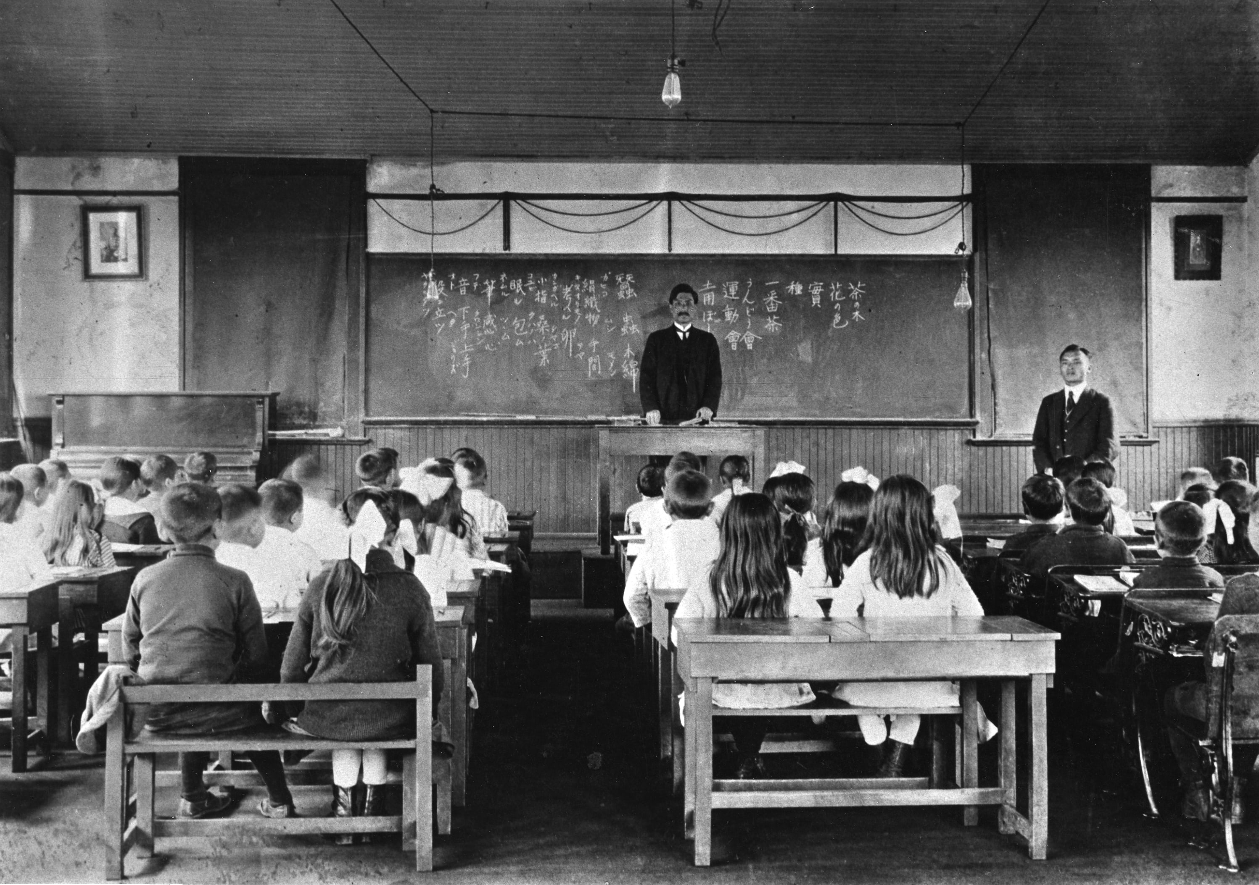
Classroom in 1919

Slide 3

Classroom in 2019

Slide 4
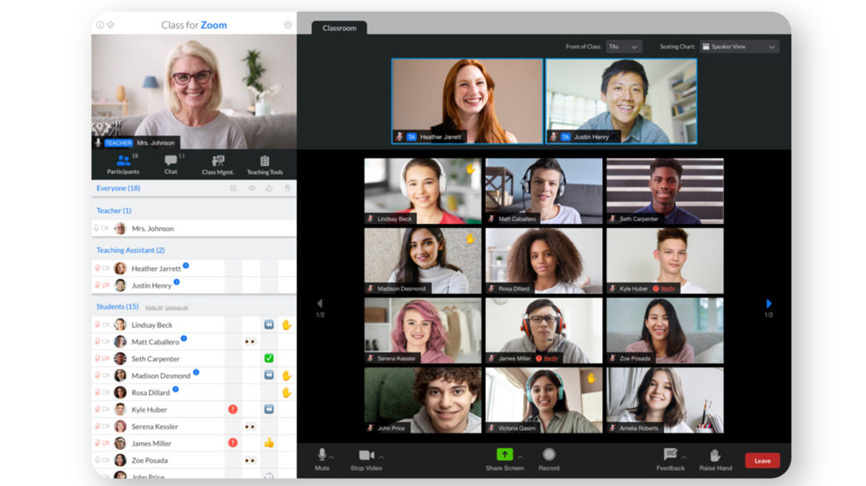
Classroom from 2020

Slide 5
Issue’s in online classrooms
Lack of Immediate Feedback : In offline classroom teacher’s can get a feedback from students whether they are understanding the concept, but in online they can’t.
Distraction among student’s : As teacher cant keep an “EYE” on every student.

Slide 6

“I-YE for an Eye”

Slide 7
Tool 1 :- Emotion Detection
This tool is developed to solve
“The Lack of Immediate Feedback “

Slide 8
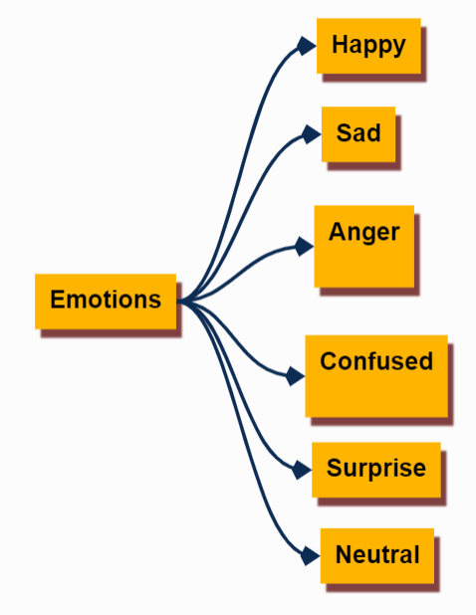
Technology used :-
Python 3,
OpenCV,
TensorFlow - Keras
Tool 1 is trained to detect 6 types of emotions expressed by a student during a classroom.

Slide 9
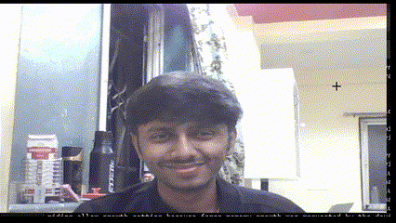
These emotion detected will be presented simultaneously on teacher’s screen in form of graph.
Above acquired data will be used as a feedback by the teacher.

Slide 10
Tool 2 :- Proctoring AI
This tool is developed to solve
“Distraction among student’s “

Slide 11
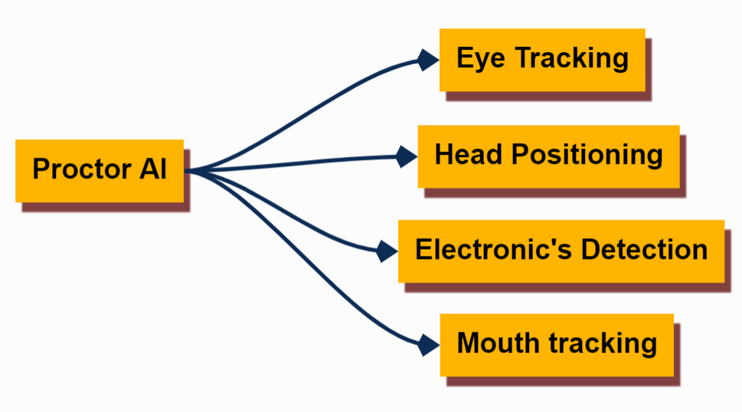
Student’s are getting distracted as there isn’t a watch on their activities.
Tool 2 is developed to provide a personal proctor to a student during the lecture.
Capabilities of tool 2 :-

Slide 12
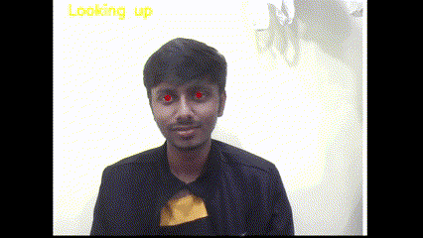
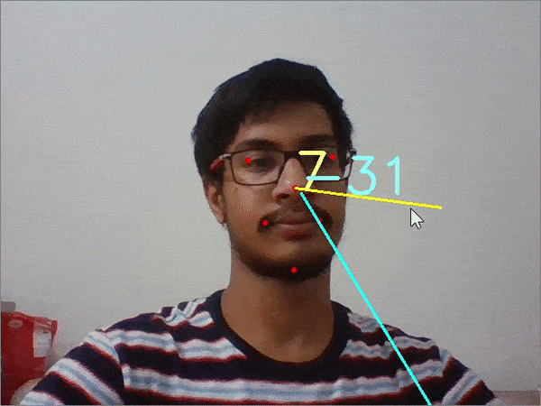
Eye Tracking
Head Positioning

Slide 13
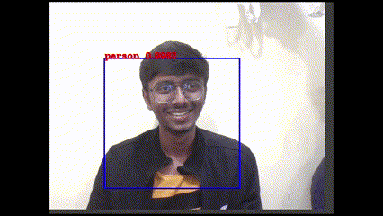
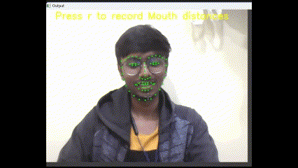
Electronic Detection
Mouth Detection

Slide 14
Thank You !

